Slide 1
Splash Pad Controller Notes
Aug 13, 2024

Slide 2
Rebuilding The Vault Machinery
Old System based on Raspberry Pi 3 and two relay banks of 8 relays each.
Decided to completely redo electronics, but keep the design based on relays instead of a custom circuit board with Mosfets.

Slide 3
Splash Pad Layout
On Patio
N
N
N
N
N
In Vault
C
A
B
C
H
A
D
E
M
F
G
H
D
I
I
J
K
F
L
G
J
B
E
N
K
L
M

Slide 4
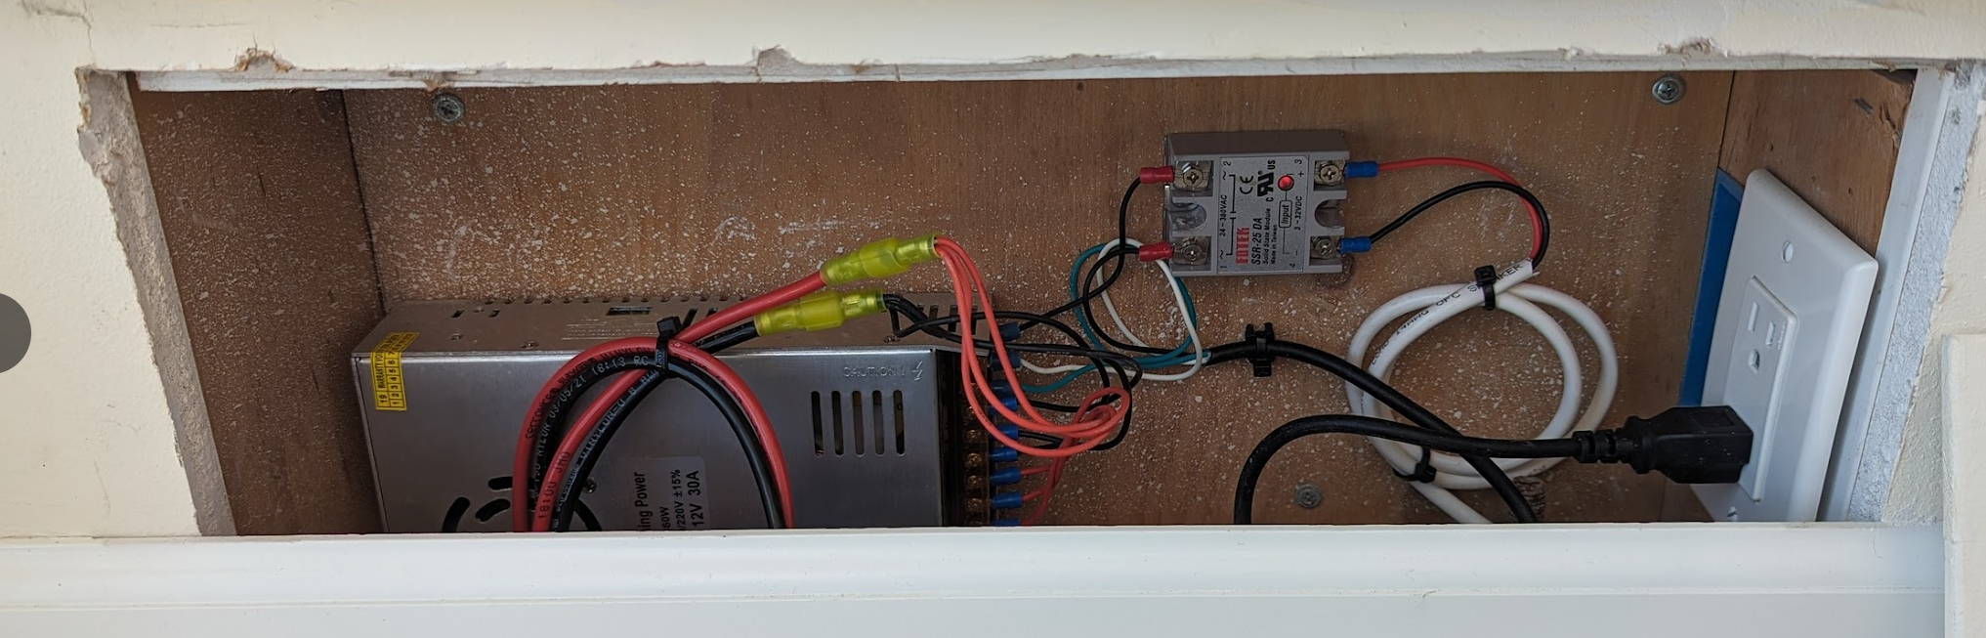
Power Control
Electronics Cabinet
In Dining Room
Vault
12v 30A PS
Switch with 9v Battery
Relay
120v AC
Power Supply in Wall under Window in Dinning Room

Slide 5
ON / OFF Control
The toggle switch in the Dining room cabinet controls power to the vault.
When the splash pad is NOT in use, the switch should be off. This will shut down all power to the vault.
When the system is off, a master solenoid valve is shut off which shuts down all water into the system.
When the system is on, a sump pump is activated if there is accumulated water in the vault. Therefore, turn the system on for a few minutes to clear water in the vault.

Slide 6
System Diagram
Ball Valve
With Open/Close Sensors
Input Pressure
Sensor
System Pressure Sensor
Master
Solenoid
Notes:
The Master Solenoid is controlled directly by the input power. If the power dies, water is shut off.
The system pressure is controlled by the Ball Valve. This means all waterspouts are supplied the same pressure at the same time.
All pipes from the supply to the channel solenoids are 1/2-inch PVC. Tubes are used after the channel solenoids.
Input Water Supply
Manifold
Channel Solenoid
To Waterspouts

Slide 7
Water Sensor
If water accumulates (from a leak or rain) in the bottom of the vault, it has no-where to go.
If accumulated water rises too high, it can destroy the machinery in the vault.
To mitigate against this, a battery powered water sensor has been installed. If more than about 1 inch of water accumulates, the sensor will emit a loud twerping sound.
To clear the water, enable the sump pump by turning on the system.

Slide 8
Raspberry Pi Setup
Using Raspberry Pi 5
Installed “Raspberry Pi OS with Desktop” – version 6.6, Debian 12
Comes with Python 3.11.2
Added 192.168.3.23 to DCHP Reservations in beach house router.
Host name of pi is “SplashVault”
Used “splash” and pw “hockeypuck” as main account in Raspberry.
Enabled SSH. Did this by using ssh-keygen on Windows, and coping the .pub file to authorized_keys on pi.
Able to SSH into pi with “ssh splash@192.168.3.23”
Did more configurations, so now able to SSH from my office computer with just:
ssh splash@SplashVault (no password necessary)

Slide 9
Using Pi Pico (RP2040) to Read Pressure Sensors
Using Micro Python. Editor: Thorny.
GP0 TX
Pico
39
5v
2.2K
VSYS
To Pi
2.2K
GP1 RX
GP27 ADC
From
Pressure
Sensors
GND 3
2.2K
GP26 ADC
2.2K
GND 33
GND 28
4.7K
4.7K
GND 23
GND

Slide 10
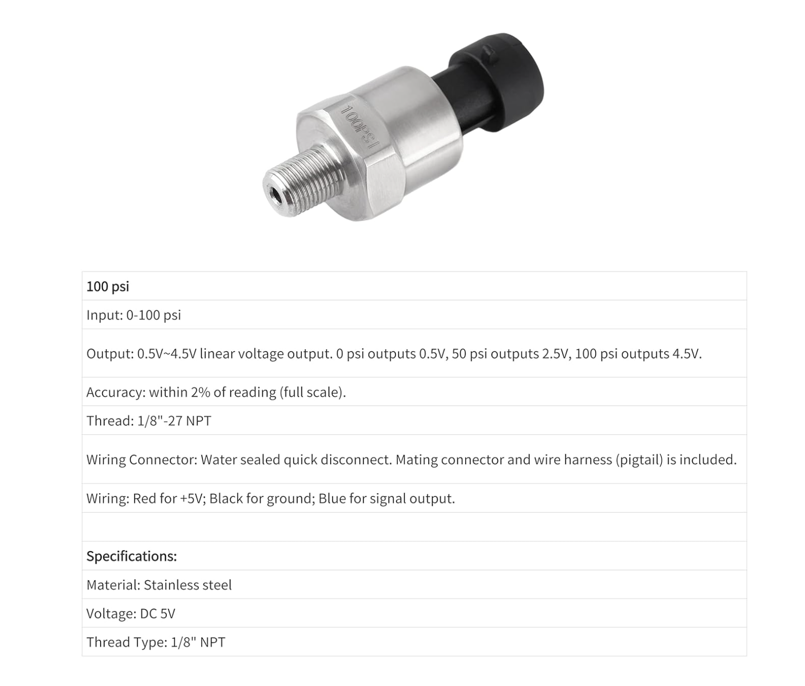
Pressure Sensor
About $15 from Amazon
Sensor
Red: 5 volts
Green: To Pico
Black: Ground

Slide 11
Code in Pico for Pressure Sensors
from machine import ADC
from machine import UART, Pin
from time import sleep
vpin1 = ADC(26)
vpin2 = ADC(27)
u = UART(0, baudrate=921600, tx=Pin(0), rx=Pin(1))
buf_input = bytearray(10)
v1 = 0
v2 = 0
def run():
while True:
sendit = False
nwaiting = u.any()
if nwaiting > 0:
u.readinto(buf_input, nwaiting)
#print("Received: ", buf_input)
for i in range(nwaiting):
if buf_input[i] == b'?'[0]:
sendit = True
break
if sendit:
s = b"%05d,%05d\n" % (v1, v2)
u.write(s)
#print("Sent: " + str(s))
v1 = vpin1.read_u16()
v2 = vpin2.read_u16()
# For Reading Pressure in splash pad vault at the Beach House.
# DLB, Aug 2024
# The splash pad machine has two pressure sensors. Each sensor
# reads PSI from 0 to 100, and outputs the reading in volts over
# the range 0.5 to 4.5 volts, where 0 psi is 0.5 volts, and 100
# psi is 4.5 volts.
# The signals from the pressure sensors are routed through a
# resistor network (2.2K/4.7K) to reduce the maximum voltage
# to about 3.1 volts, and then presented to GPIO Pins 26 and 27.
# The ADC is used to produce 16 bit readings. These readings
# are encoded as follows: "xxxxx,yyyyy/n" where x and y are
# digits of the two readings. This string is sent over a
# 921600 baud link to the host computer, each time the host
# requests the reading by sending a "?".

Slide 12
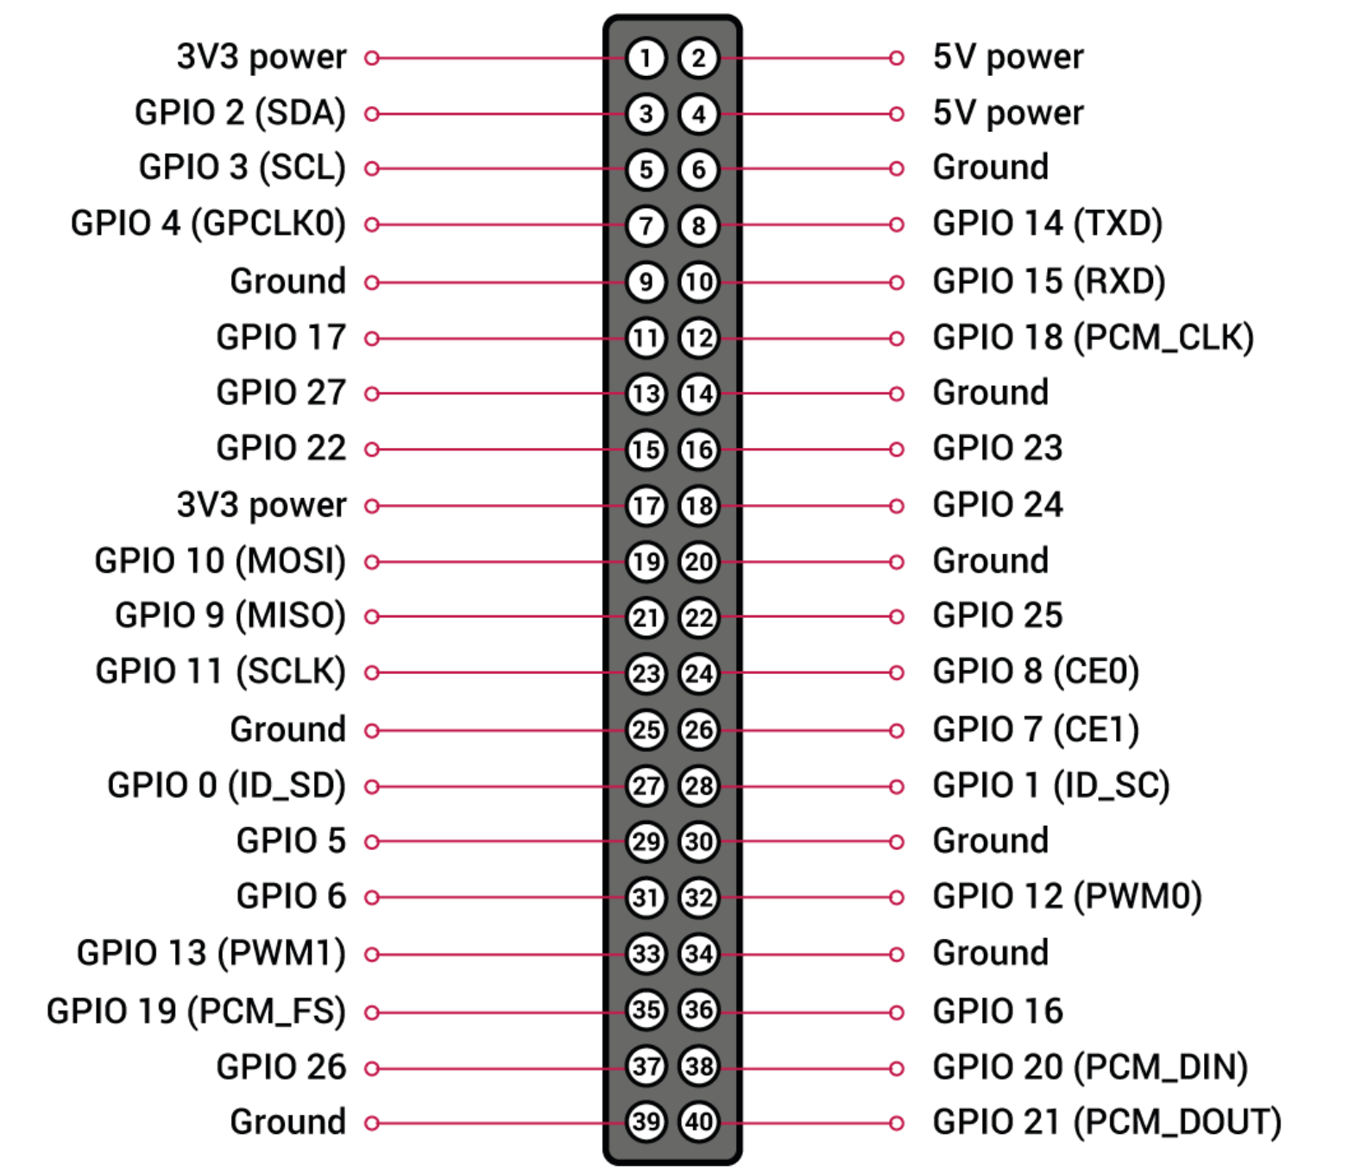
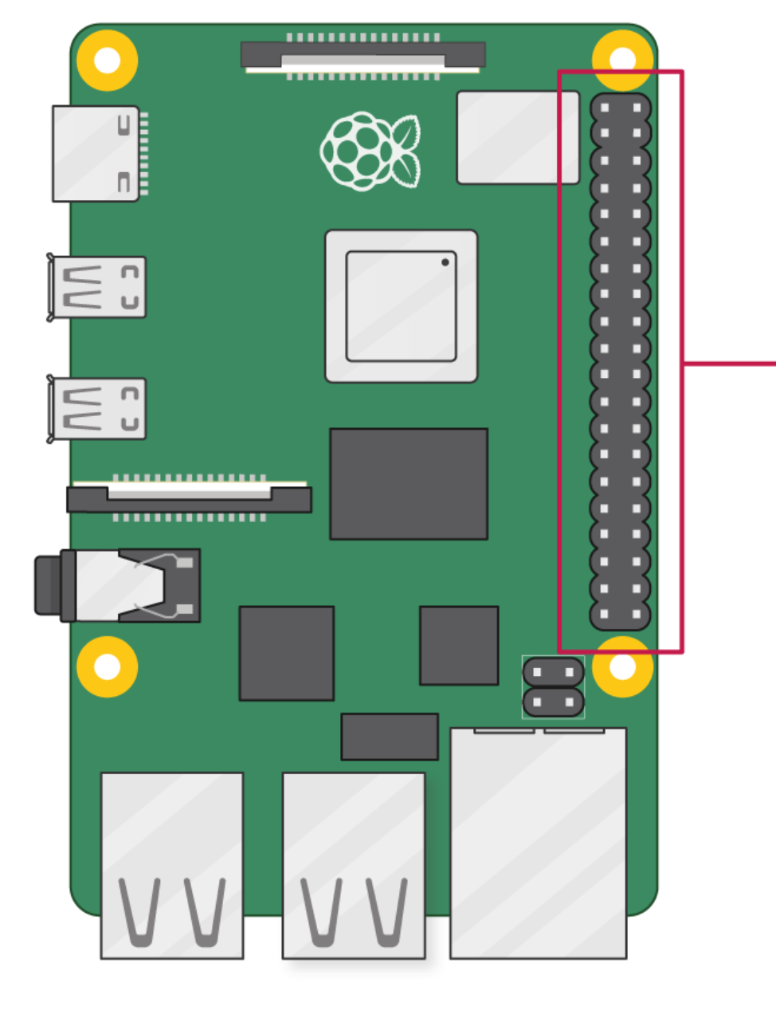
Raspberry Pi 5 Pinout Diagram
Pin 1

Slide 13
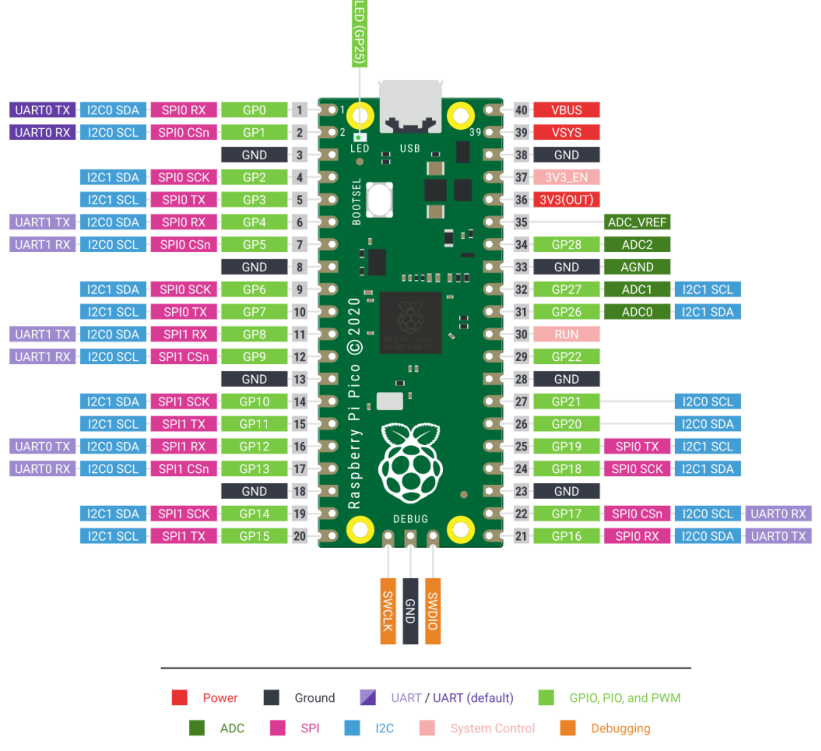
Pico Pinout

Slide 14
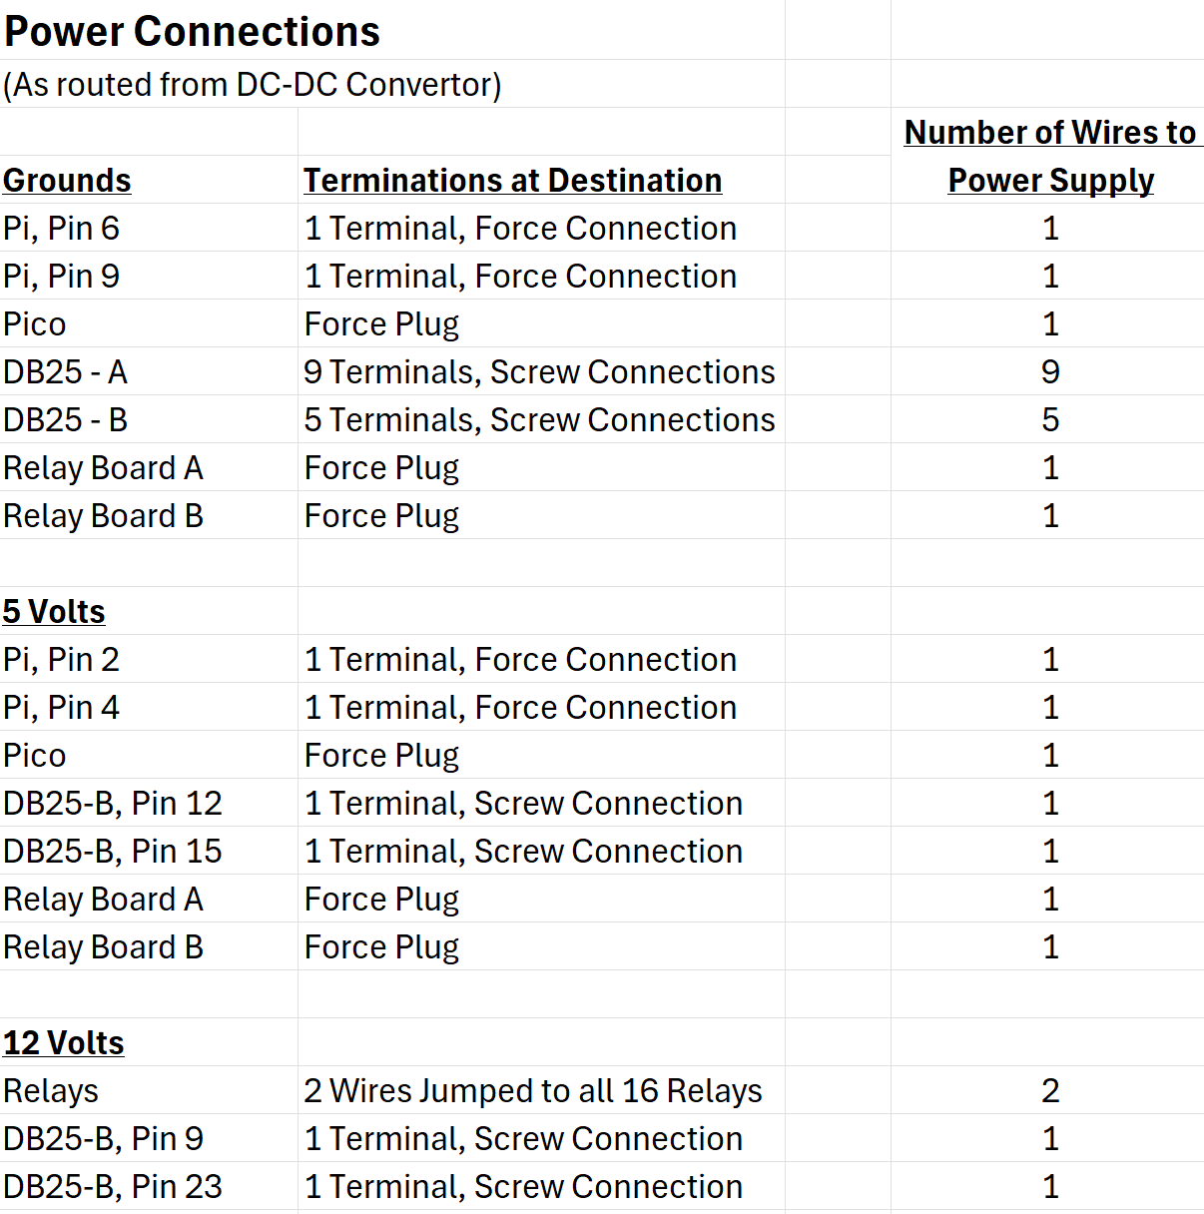
Power Connections

Slide 15
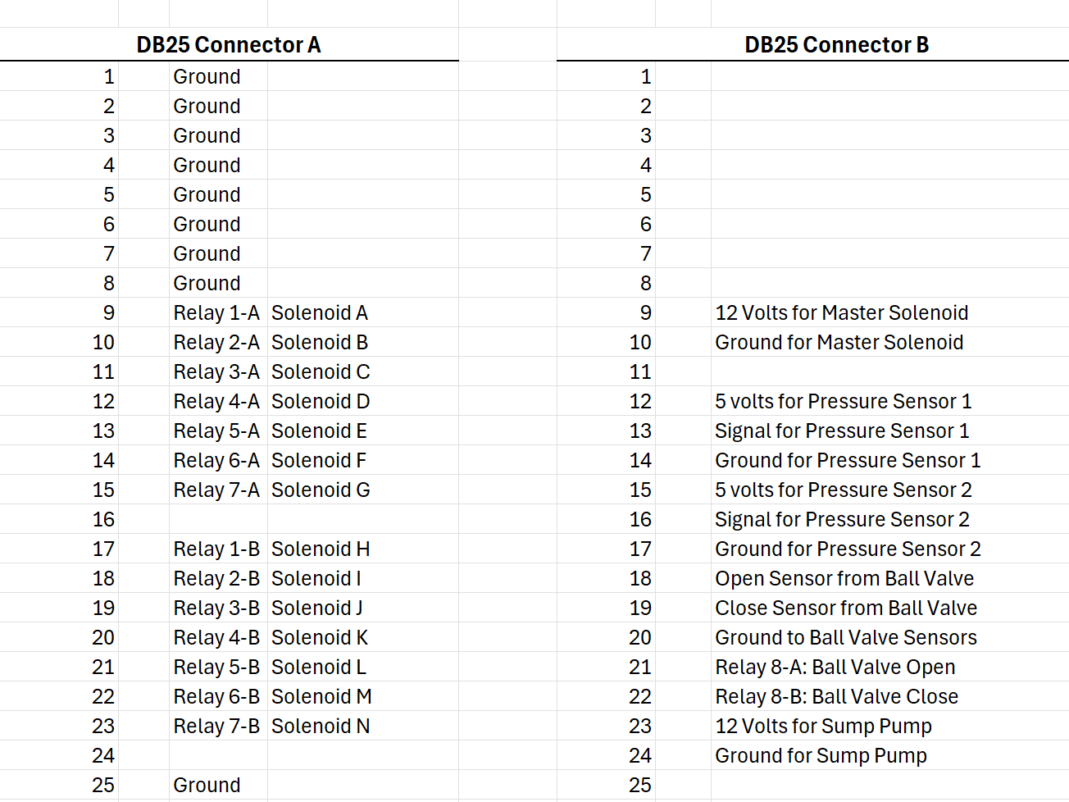
DB25 Connections

Slide 16
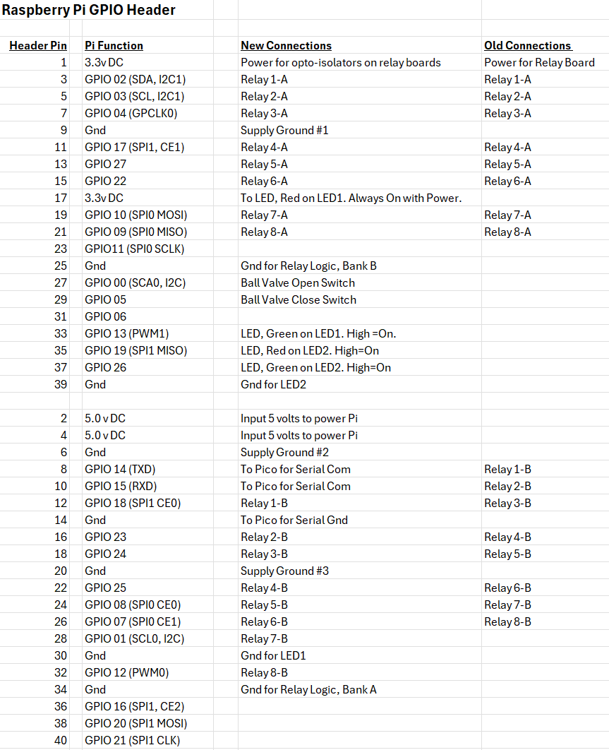
Raspberry Pi GPIO Connections

Slide 17
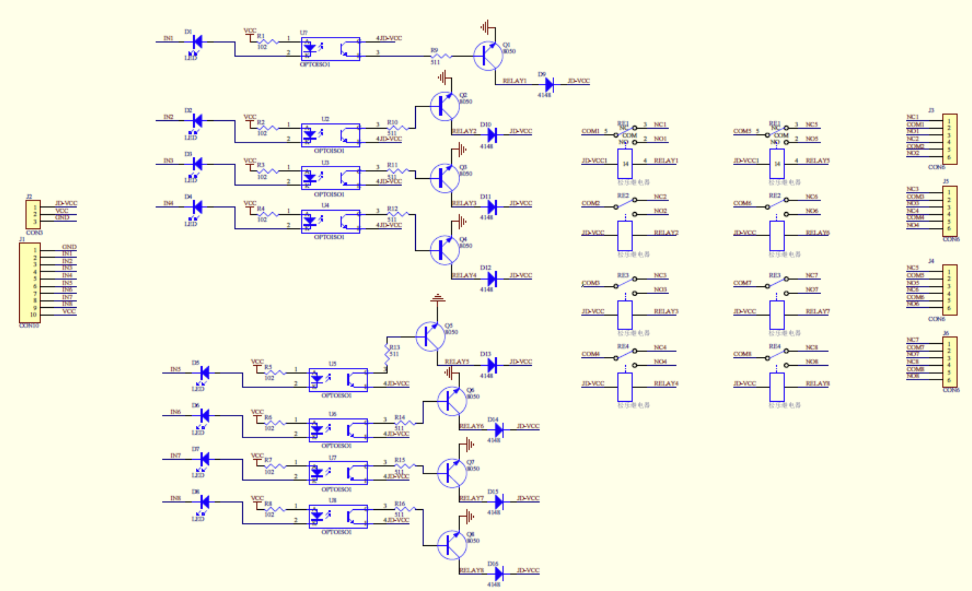
Relay Module Schematic

Slide 18
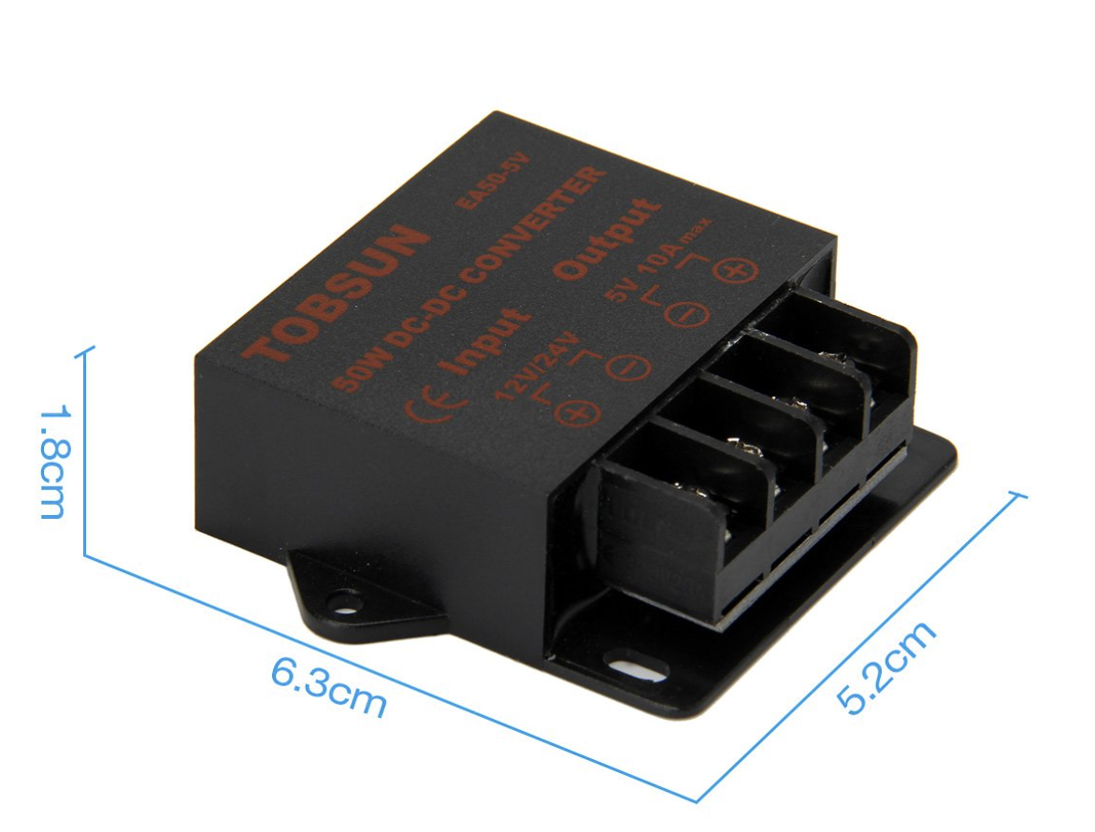
Power Conversion in Splash Controller Box
Power Input is 12 volts at up to 30 Amps
12 Volts used for all Solenoids
5 Volts used for Pi, Pico, Relay Boards and Pressure Sensors
3.3 Volts (Produced by Pi) used for Logic side of Relay Boards
Almost all current carrying wire used in the controller box is 20 AWG Silicon wire.
20 AWG wire is rated to 5 Amps.
20 AWG silicon wire has a resistance of 62.50 ohms per km, or about 0.01 ohms in a foot. At 30 Amps, Voltage drop would be 0.3 volts. Wire would need to dissipate 9 Watts. (Not good)
DC-DC convertor. Input: 12-24 volts.
Output: 5 Volts at 10 Amps

Slide 19
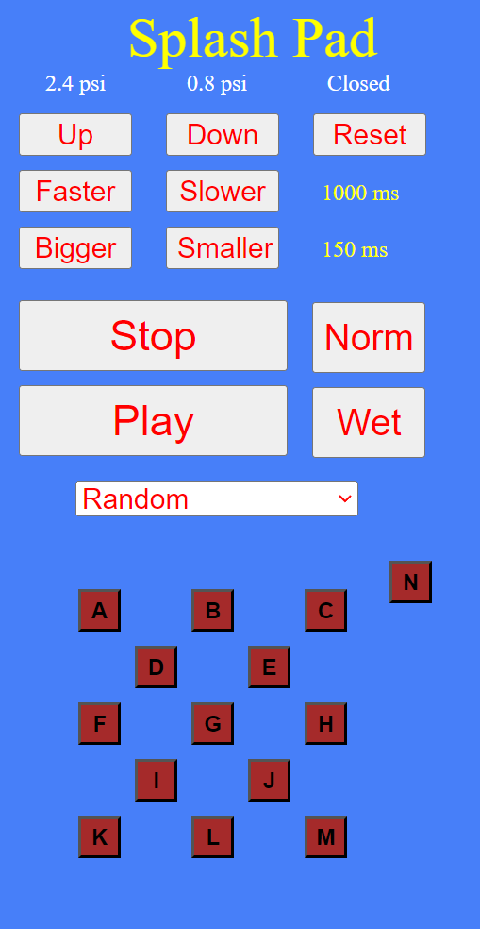
Spash Pad Control Website
Reset completely closes the flow control valve.
Access this website at:
192.168.3.23:5000
Controls the overall water Flow.
Controls the cadence of the program.
Controls the duration of each squirt
Stops a running program
Norm sets up the flow, cadence and duration for typical operation.
Runs the program indicated
by the pulldown below.
Wet sets up the flow, cadence and duration for wetter operation.
Program selection pulldown
Note: the flow, cadence and duration controls
do not work with all programs. That is,
some programs take over control of these
parameters.
Allows individual control of each spout. (Shuts off any running program.)
Note: The status numbers only update on a
page refresh.

